Slide 1
Welcome Gerenuks
Byte Academy
March 2016

Slide 2
GERENUKS

Slide 3
Your Instructional Team
Jason Ng
Team: Gerenuks
Jeff Maxim
Team: Gordons
Thomas Harvey
Team: Narwhals
William Mantly
Instructional Lead

Slide 4
Who Are You?
Introduce yourself
What is your name?
What did you do before this?
Why did you choose to learn programming?
What is your third favorite movie?
If you could have a super power what would it be?

Slide 5
Your Learning Experience

Slide 6
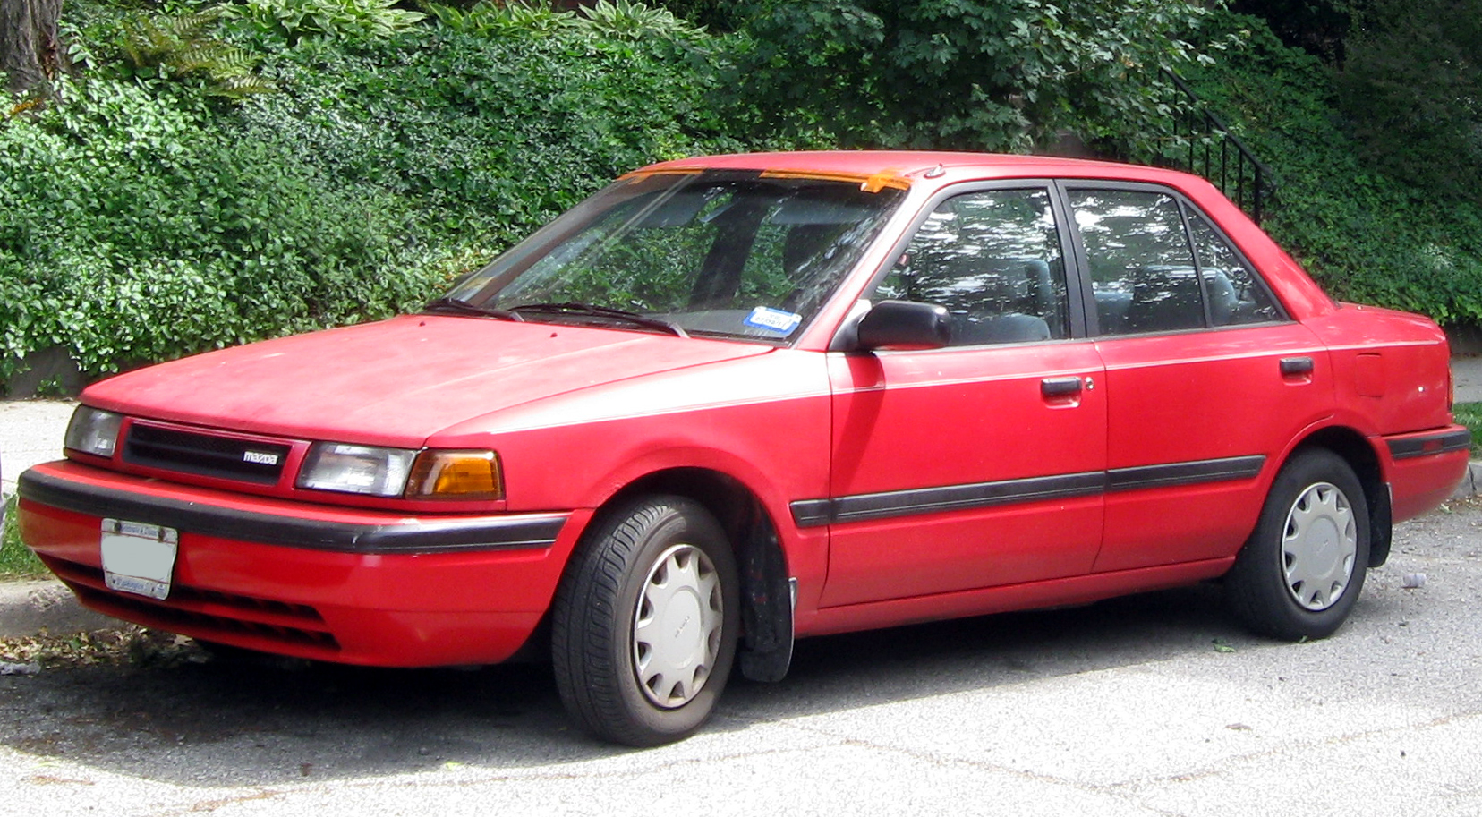

Slide 7
Pseudo Learning Experience
Work together for the next 5-10 minutes
Write down how you would prepare to complete the below tasks, as a group
I’m not asking for any measurements of numbers/reps/miles. What kind of steps will you take to make sure you succeed.
Group A - Complete an Iron Man Triathlon
Group B – Climb Mount Everest
Group C – Move to a country you have never been and do not speak the language.

Slide 8
Processes and Answers
Account for different backgrounds
What does growth look like
How do you define success
Do you have roles? Guides? Coaches?

Slide 9
ALRIGHT BREAK!

Slide 10
Your Immersive experience
The end goal is to teach you how to teach yourself
Your schedule and resources
10 a.m. – 6 p.m. Monday through Friday (Immersion Hours)
Lectures will be held in the morning for 1-2 hours
90 minute lunch break
Afternoons will be spent programming and pair programming
Instructors and TA’s will be here to help you with assignments during the day. After 6pm and on weekends they can be reached on Slack . There are no guarantees how accessible instructors will be outside of immersion hours.
You are welcomed and encouraged to stay here and continue working together after 6pm and on weekends.
Github – All lessons and assignments will be posted here.
Jeffit – Online discussion forum written by Jeff Maxim

Slide 11
Some Ground Rules
Be respectful of each other
Leave your ego at the door
Positive criticisms
Noise Level
Classes / Events / Workshops / Phone Calls
Your Workspace
Please keep it clean
Do not keep expensive things here/openly overnight
Be careful of open containers

Slide 13
Advice For Success!

Slide 14
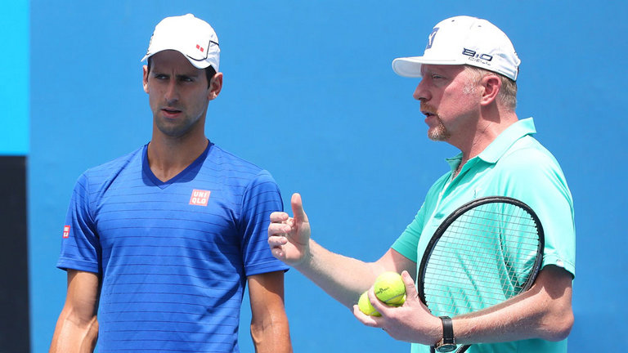
Be open to coaching

Slide 15
Have a plan to get unstuck
Work on it for 15 minutes.
You solved it! 2. You didn’t figure it out.
Celebrate!
Now, you’ve gotta do something. Options include:
“Rubber duck” it
Post your question on Jeffit
Ask a classmate
Ask an Instructor / TA

Slide 16

Take Care Of Yourself

Slide 17
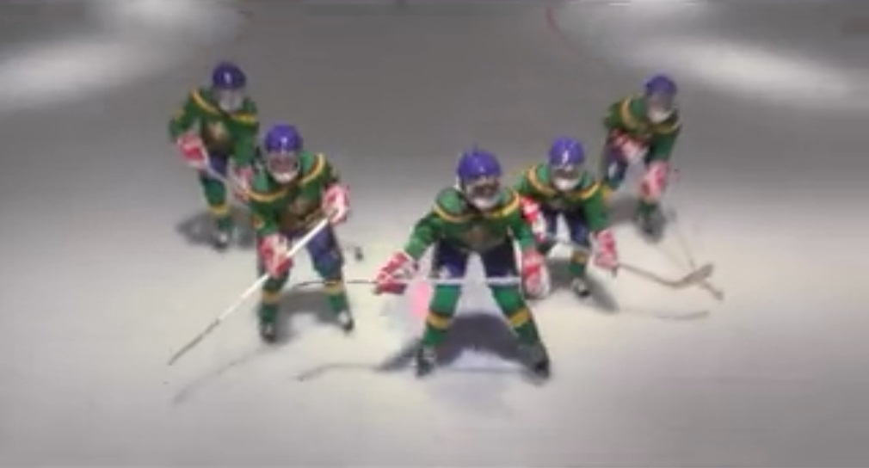
Take Care of Each Other

Slide 18
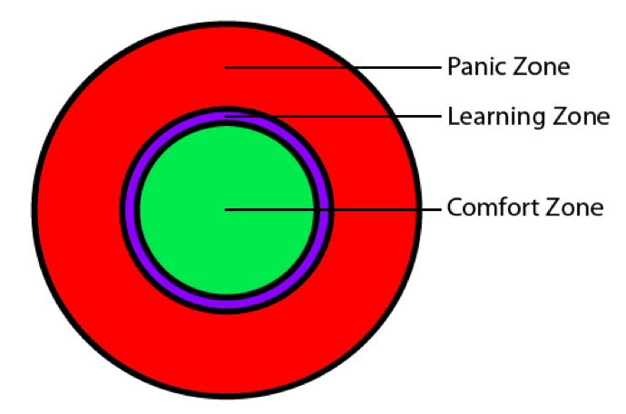
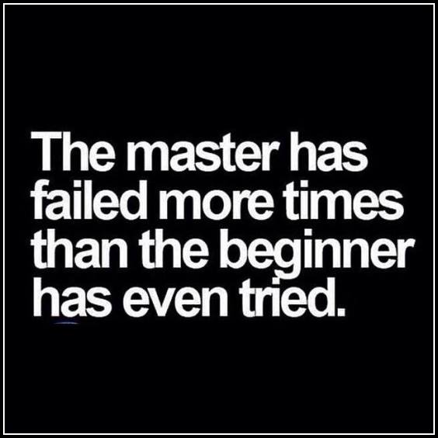
Enjoy the struggle
Your byte academy goal: teach you to teach yourself ← you learn that by failing. a lot.

